Slide 1
ADVANCEMENT OF FOOD INDUSTRY USING BLOCKCHAIN TECHNOLOGY
Student 1 (201CS296 & SONA S)
Student 2 (202BT201 & VISHALI V)

Slide 2
Abstract
Inside a market consisting of sellers, buyers, shippers, banks and other participants, offers can be published by the sellers at a certain price for a specific buyer, while the others to buy at the standard price.
The details of the proposed deals are confidential. If the participants are not part of the deal, then the transaction does not appear on their ledger . The identity is found from the membership service and sends the transactions only to specific peers. Each peer triggers a result, the transaction being validated if both peers provide the same result. The peers deliver the validated transactions back to the application which forwards it to the consensus for ordering, after which the transactions are sent to the peers and stored inside the ledgers . More parties are involved inside a transaction, such as the authorities, shippers, banks, but they do not need to know the details about the deal's price.
The supply chain needs the Blockchain pattern to manage confidential transactions without forwarding everything through a central authority The deals and the transactions are stored inside the NoSQL database, CouchDB , using the JSON format. In this way queries can be done fast on a big amount of data. The Hyperledger Fabric platform uses CouchDB as a database due to its key-value storage, as well as GoLevelDB [16], which is an embedded database.

Slide 3
Problem Statement Addressed
The traceability of products and their components is a major challenge in the food industry, but also for the raw material producers.
Exterior problems such as breakdown of transport system will cause wastage of food.

Slide 4
Existing Solution to the Problem Addressed
When a product undergoes a processing process, the information relating to that product must be processed so as to maintain the link between the product and the information
Nowadays this information is stored in database where there are opportunities of fraudulent and also these datas are not visible to the end customers
In food transportation ,there are many chances of failure along the way which are not identified in correct time due to existing system resulting in loss .

Slide 5
Proposed Solution to the Problem Addressed
Inside a market consisting of sellers, buyers, shippers, banks and other participants, offers can be published by the sellers at a certain price for a specific buyer, while the others to buy at the standard price.
The details of the proposed deals are confidential. If the participants are not part of the deal, then the transaction does not appear on their ledger .
The identity is found from the membership service and sends the transactions only to specific peers. Each peer triggers a result, the transaction being validated if both peers provide the same result.

Slide 6
Project Work Plan
The peers deliver the validated transactions back to the application which forwards it to the consensus for ordering, after which the transactions are sent to the peers and stored inside the ledgers . More parties are involved inside a transaction, such as the authorities, shippers, banks, but they do not need to know the details about the deal's price.
The supply chain needs the Blockchain pattern to manage confidential transactions without forwarding everything through central authority.
The deals and the transactions are stored inside the NoSQL database, CouchDB , using the JSON format.
In this way queries can be done fast on a big amount of data. The Hyperledger Fabric platform uses CouchDB as a database due to its key-value storage, as well as GoLevelDB [16], which is an embedded database.

Slide 7
Effective utilization of the Modern Tool & Cloud
We are using Blockchain Technology for solving this problem.
Blockchain is a shared, immutable ledger that facilitates the process of
recording transactions and tracking assets in a business network. An asset can be tangible (a house, car, cash, land) or intangible intellectual property, patents, copyrights, branding). Virtually anything of value can be tracked and traded on a blockchain network, reducing risk and cutting costs for all involved.

Slide 8
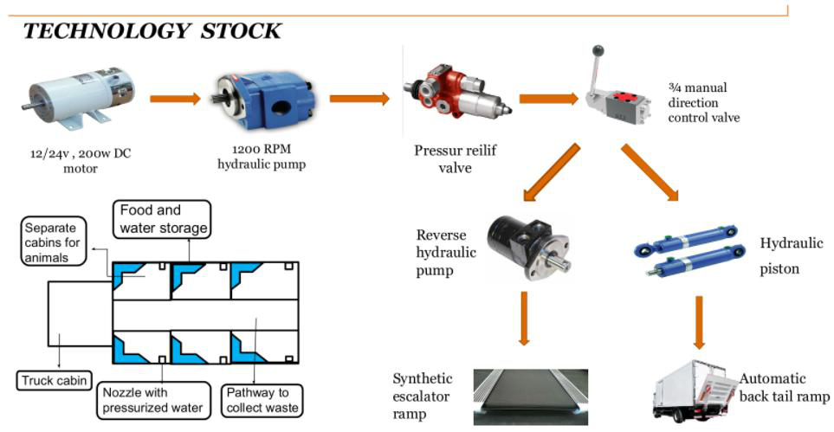
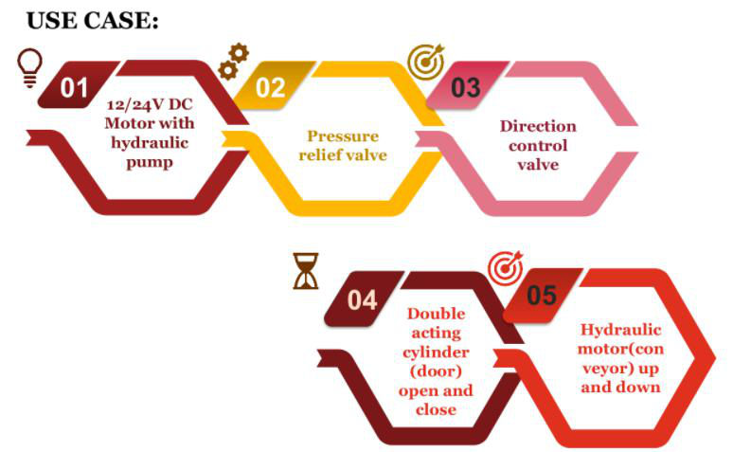
Technology stack & use case

Slide 9
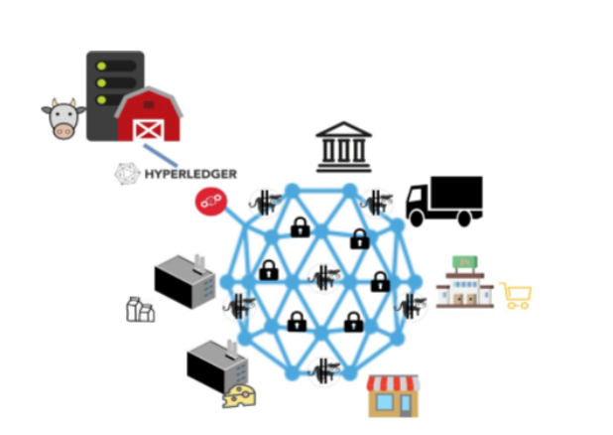
Prototype & Sample Output

Slide 10
Analysis of Results & Discussions
The customers we are targeting for the project will be ranging from manufacturers to consumers.
The product can be trustworthy for the consumers as the traceability of the food is known.
The interchanging of the food products starting from the raw materials to the final product, all exchange will be recorded in the ledger. So, the product can be tracked at any point
Using the RFID tags, it can be tracked the entire path traveled by the raw material.
The dynamic QR code is then printed on the packaging. This QR code contains all the information issued by the RFID tags together with information that is gradually enriched by the different participants in the supply chain.
Consumers can scan the QR code on the packaging to get all the information about the product stored in the blockchain blocks.
In order to ensure maximum transparency, customers can also check data about the used blockchain technology.

Slide 11
References
7 Benefits of Blockchain Development for Food Industry - DataScienceCentral.com
Applications of blockchain technology in the food industry - New Food Magazine
Blockchain Impact On Future Agriculture and Food Industry (appinventiv.com)

